Slide 1
Cybersecurity Evaluation of Citibank
Presented by: Christopher Gonzalez

Slide 2
Introduction & Purpose
Cybersecurity is defined as the protection against unauthorized use of an organization’s assets (i.e. data, systems, applications).
The purpose of the evaluation is to assess the current cybersecurity practices through the lens of the NIST Cybersecurity Framework.
This assessment aims to determine the strengths and weaknesses of Citibank’s practices while offering opportunities for improvement.
The NIST Cybersecurity Framework was selected for its flexibility and universal applications across industries of all sizes.

Slide 3
Evaluation Process & Maturity Levels
The process began by aligning the organization’s current controls with the core functions/categories listed in the framework.
In total, 118 implementations were assessed using a maturity level grading criteria that goes from a scale of 1-5.
A rating of 1 signifies the lack or absence of cybersecurity, whereas a 5 represents the highest level of maturity in the given practice.
Generally speaking, organizations should aim for a maturity level of 3 across all core functions of the NIST Cybersecurity Framework.

Slide 4
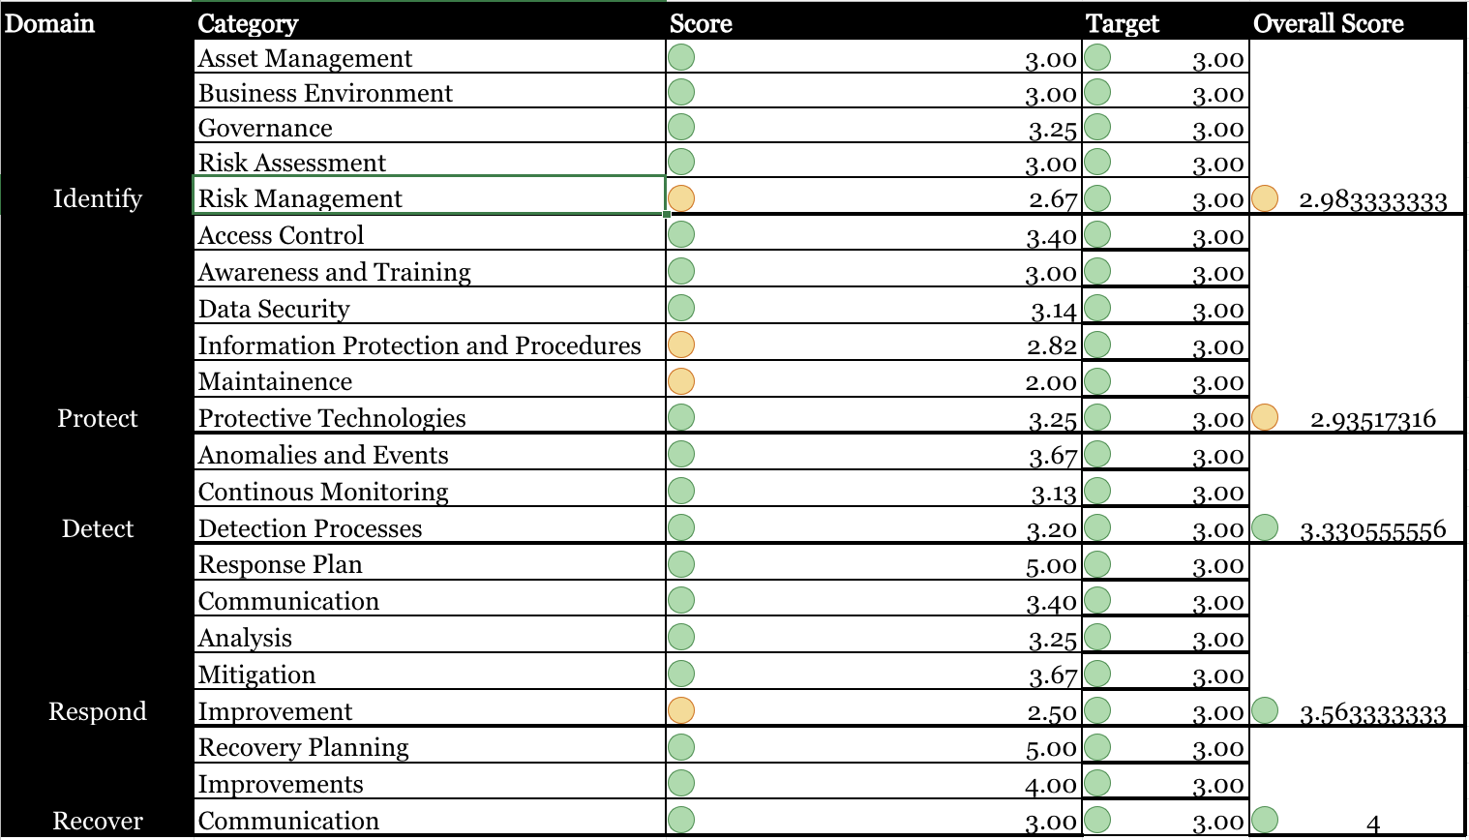
Performance of Citibank

Slide 5
Key Findings & Areas for Improvement
Citibank’s key strength can be seen in the current implementations of recovery and response efforts.
On the other hand, the organization struggles in identifying cybersecurity risks and protecting from the impact of threats.
As a suggestion, the organization should consider increased remote access controls and enhanced risk evaluation documentation.
This can be achieved via the Principle of Least Privilege, strengthening sector-specific analyses, and increased CVE monitoring.

Slide 6
Conclusion & Next Steps
Citibank has demonstrated strong cybersecurity resilience in terms of “Response” and “Recovery”.
However, “Protection” and “Identification” efforts need minor improvements to meet the target level.
Please consult with your Chief Information Security Officer (CISO) for better asset management documentation.
By addressing the identified gaps, the organization will enhance its cybersecurity standing in comparison to rivaling industries.

